Slide 1

EEE-511 (Artificial Neural Computation) Final Project Presentation
Effective Incorporation of Term Importance and Attention, in Designing Question Answering and Natural Language Inference
TEAM-16 (Individual team)
Suryadipto Sarkar
School of Computing, Informatics, Decision Systems Engineering (CIDSE)
Arizona State University
Tempe, AZ, USA
1216403422
ssarka34@asu.edu

Slide 2
Improving attention
Design
Results
Simulations
Topics covered
Improving context
Results

Slide 3
I. IMPROVING ATTENTION

Slide 4
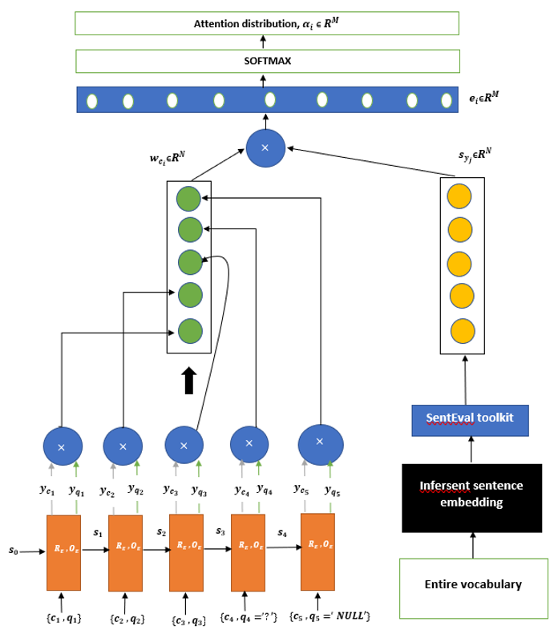

DESIGN
$RNN\left(s_{0} ,c_{1:n} ,q_{1:n}\right)=s_{1:n} ,y_{c_{1}:c_{n}} ,y_{q_{1}:q_{n}}$
$s_{i}=R\left(s_{i−1} ,c_{i} ,q_{i}\right)$
$y_{c_{1}}=O_{1}\left(s_{i}\right)$
$y_{q_{1}}=O_{2}\left(s_{i}\right)$
$w_{c_{i}}=y_{c_{i}}•y_{q_{i}}$
$e_{i}=\left[y_{c_{i}}^{T}q_{1},…,{y_{c_{i}}^{T}q}_{M}\right] ε R^{M}$
$α_{i}=softmax\left(e_{i}\right) ε R^{M}$
Second-phase attention score computation:$a_{i}=\sum_{j=1}^{M}{α_{i}q_{j}}$
Another layer of softmax → This gives an array of probabilities corresponding to each question $q_{j} , j=1 to M$
Optional steps: Some papers use one or two fully connected feedforward networks in the end, followed by a final layer of softmax. However, that is not something I chose to do.
Also known as “dot product attention.”

Slide 5
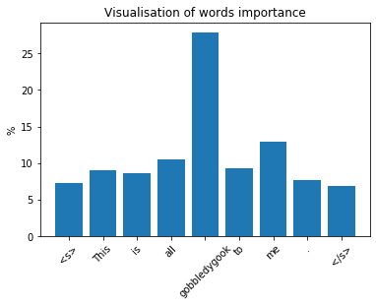
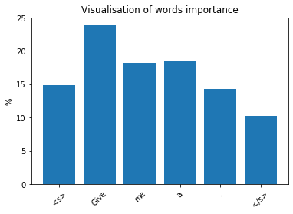
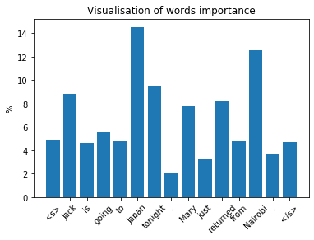
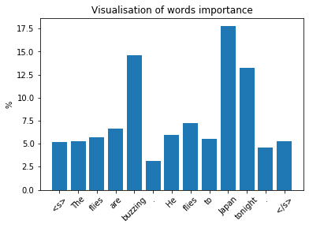
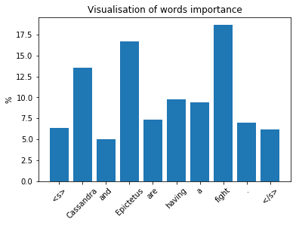
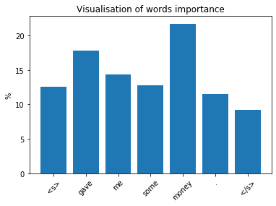
IMPORTANCE SCORE GENERTION from SentEval
Leaves out nonsense words:
Names of places—very high value; names of people—high value:
Rare words → more importance:
“This is all gobbledygook to me.”
Same word given different score, based on context:
“Give me a shpen.”
“Jack is going to Japan tonight. Mary just returned from Nairobi.”
Differentiates rare and nonsense names:
“The flies are buzzing. He flies to Japan tonight.”
“Cassandra and Epictetus are having a fight.”
“Bibbob gave me some money.”

Slide 6
RESULTS
Dataset:
The Stanford Natural Language corpus
Accuracy: 73%
Best performing state-of-the-art LSTM models:
Model | Accuracy(%)
1D LSTM | 80
biLSTM-Mean | 78.2

Slide 7
II. IMPROVING CONTEXT

Slide 8
RESULTS of Context Improvement
Dataset: HotpotQA multi-hop QA dataset
Model | F1-score (%)
BERT (1-hop trained) + proposed embeddings | 33
BERT (1-hop trained) | 29.97
BiDAF + proposed embeddings | 35
BiDAF | 32.89

Slide 9
SUGGESTIONS / QUERIES
If you have any suggestions, or queries, feel free to drop me an email at ssarka34@asu.edu

